Slide 1
Google Play Store
DAB 103
Analyti Tools & Decision Making
Group 4 | Prof. Ali Elsharif

Slide 2
INDEX
01 | Problem Statement
02 | About Dataset
03 | Descriptive Statics And EDA
04 | Visualizations
05 | Data Cleaning
06 | Data Analysis
07 | Dashboard
08 | Conclusion
09 | Links of Project and Tableau
10 | About Team

Slide 3
PROBLEM STATEMENT
An enlargement of smartphones is driving the rapid development of mobile app stores. Nowadays, the two largest platforms for app distribution are Google Play-store and Apple App Store. We chose Google Play-store data for our project. Google Play-store has more than 10 million apps. It is divided into various categories like action, adventure, arcade, music, finance, sports, tools, etc.
There are various factors that can lead users to download any particular app. Our goal is to help app developers and organizations to know what is the motivating factor for many people to download an app. It will also find out that how these factors affect any person's decision to download an app. We would like to analyse some data fields like category, price, Ad supported, ratings, size and installs for this purpose and find out how these fields are related to each other.

Slide 4

DATASET
Google Play-Store Data :
This Data contains 1118136 observations and 36 Columns.
Dataset-Link :
https://www.kaggle.com/gauthamp10/google-playstore-apps

Slide 5
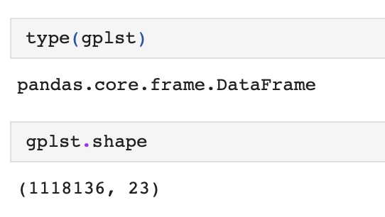
Descriptive Statistics And EDA
Understanding the Dataset :
Dimensions & Type of Dataset

Slide 6
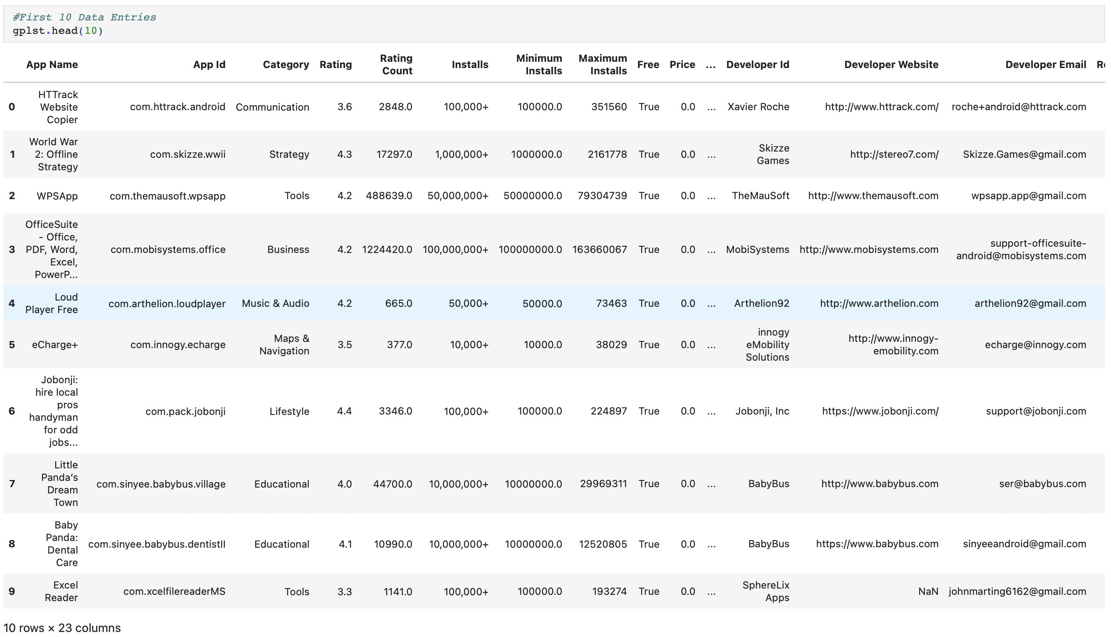
First 10 Rows of Dataset :

Slide 7
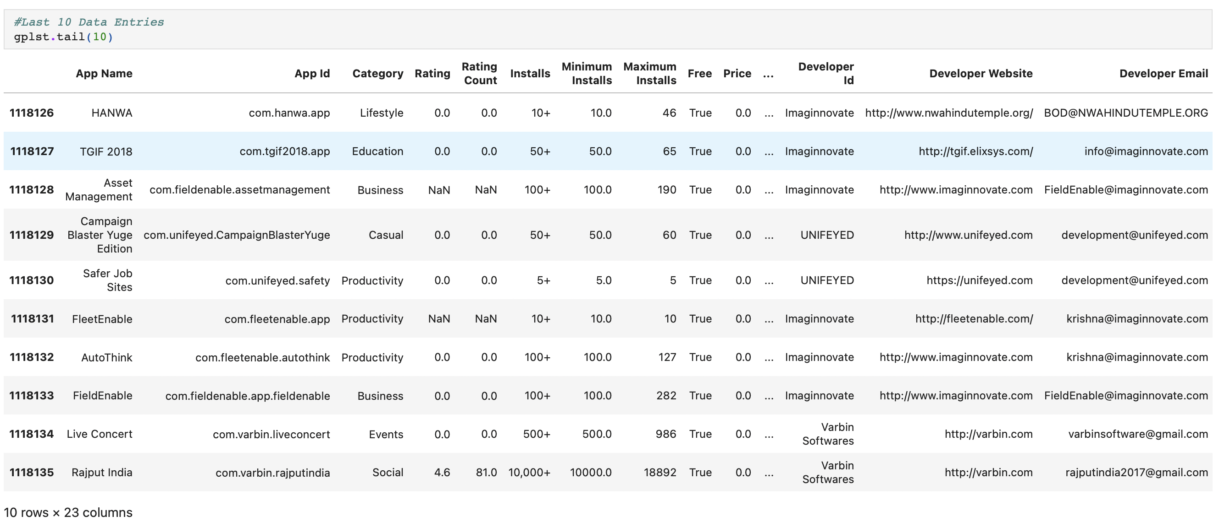
Last 10 Rows of Dataset :

Slide 8
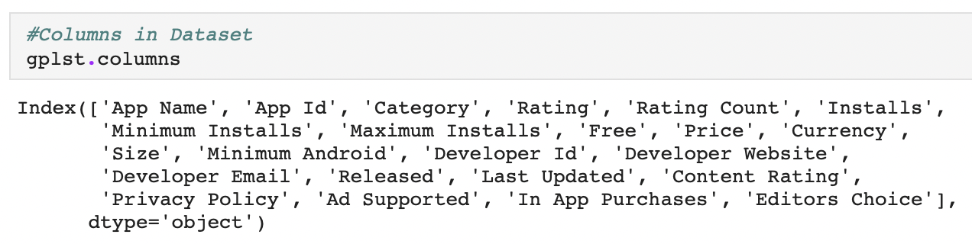
Columns in Dataset :
These are the columns in our Dataset.

Slide 9
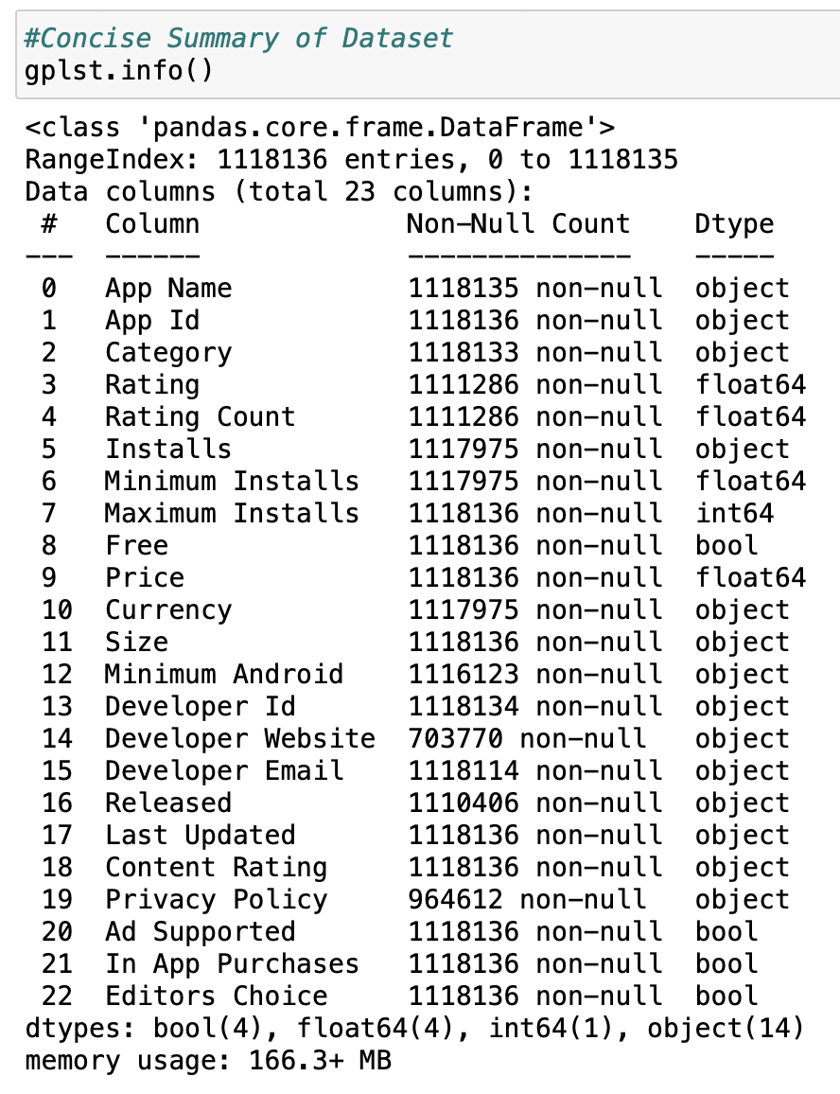
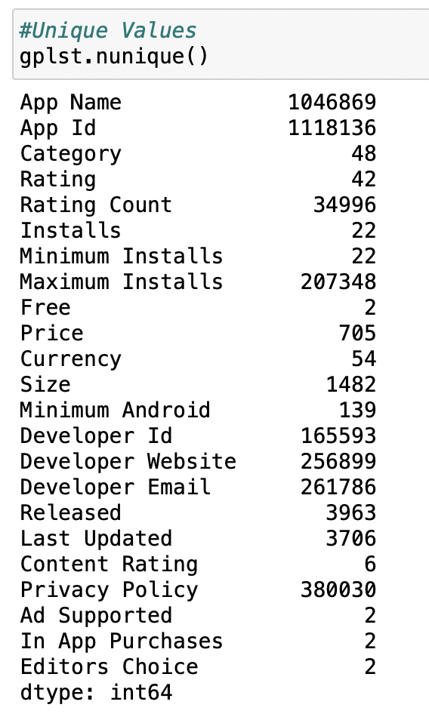
Finding Datatypes & unique values of each Column:
We used info() function for datatype, count and other parameters .
Also, we used nunique() functions that helps us to find out the total unique values as it can be further classifies as numeric, ordinal or categorical.

Slide 10
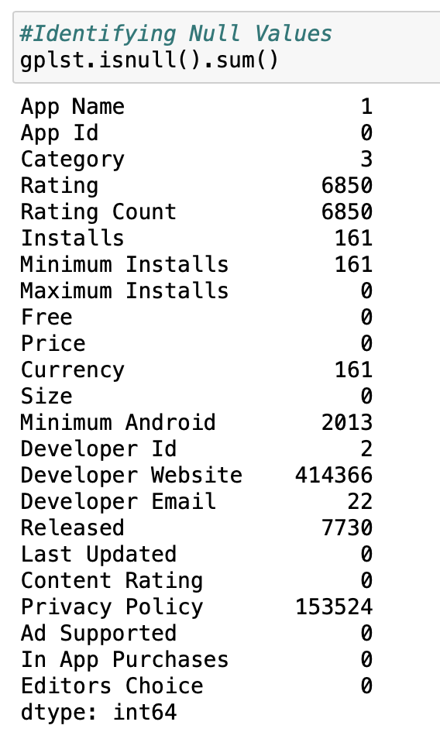
Null values :
This shows all null values present is each columns.

Slide 11
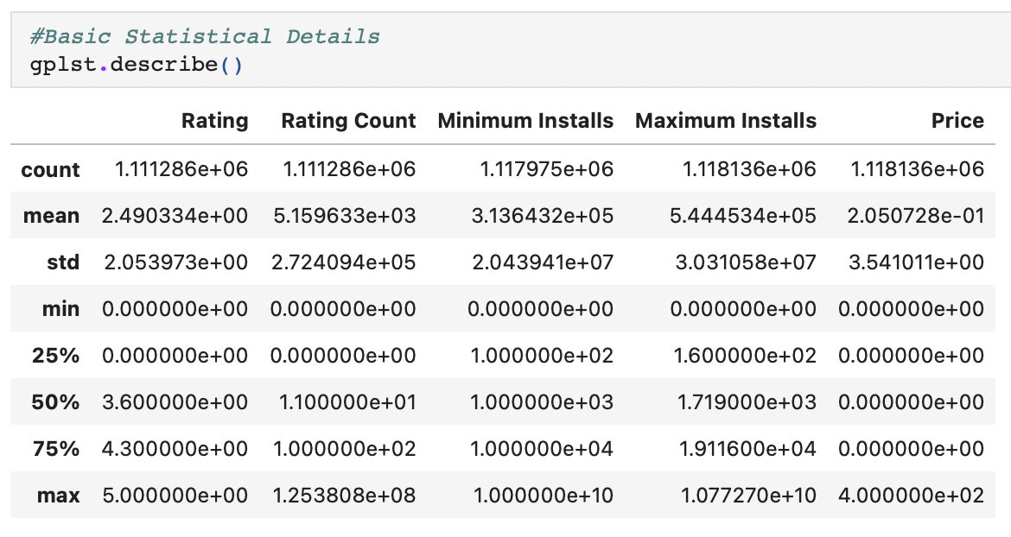
Basic Statistical Details :
It shows some important measures for all numeric columns in dataset.

Slide 12
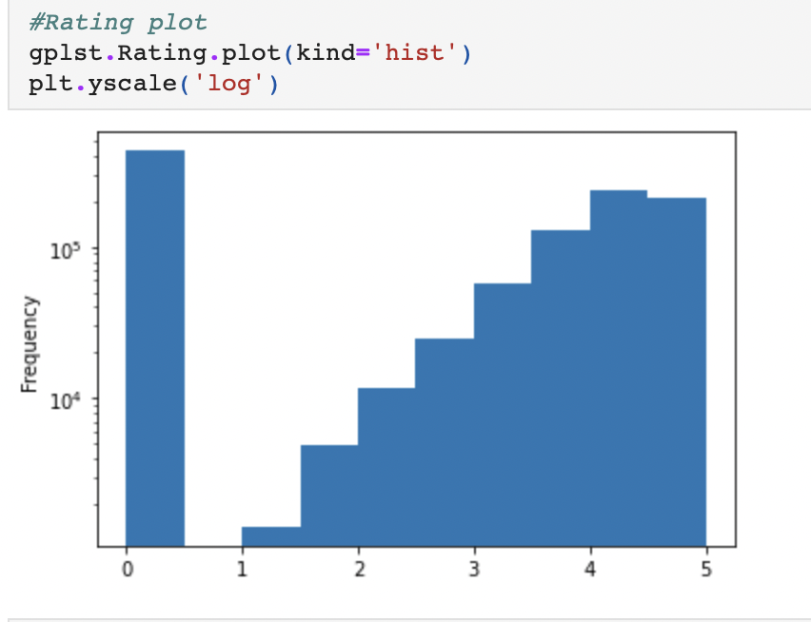
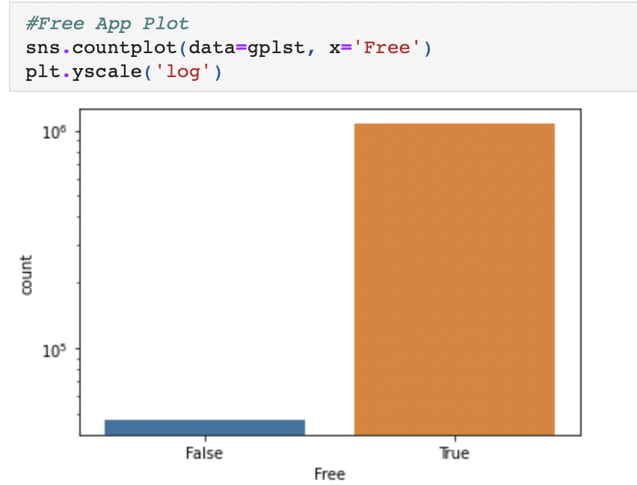
Visualizations
Rating Plot :
Free-App Plot :
Here We can say that in Rating plot except from 0 the number of count increasing gradually and in
Free plot count of free apps too much higher than paid ones.

Slide 13
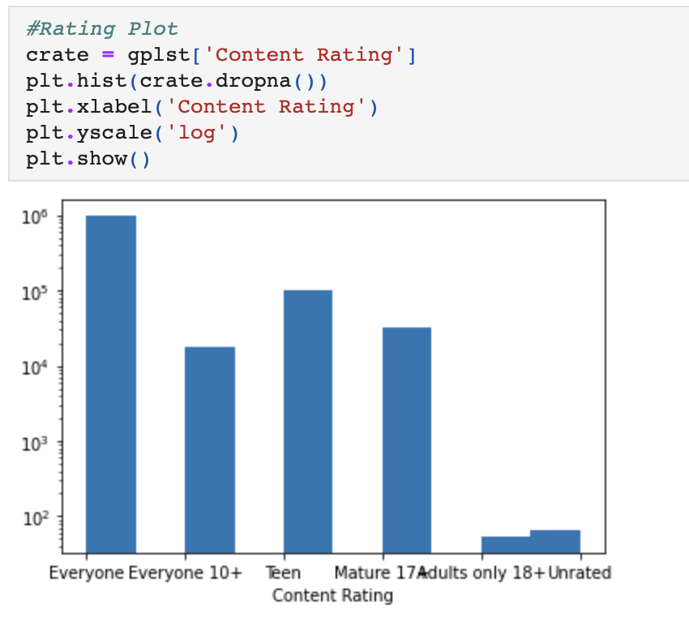
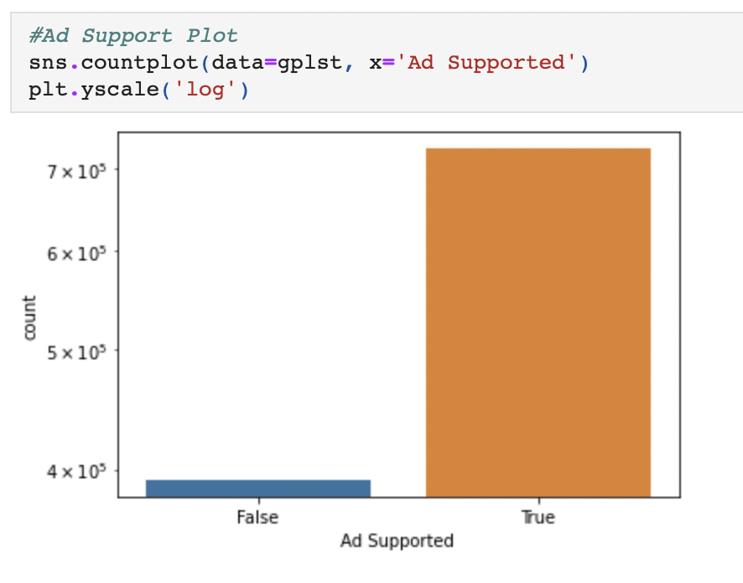
Content Rating Plot :
Ad-Supported Plot :
Here We can say that in Content Rating plot the shape of distribution is right skewed and in
Free plot count of Ad-Supported apps too much higher than without Ad-supported apps.

Slide 14
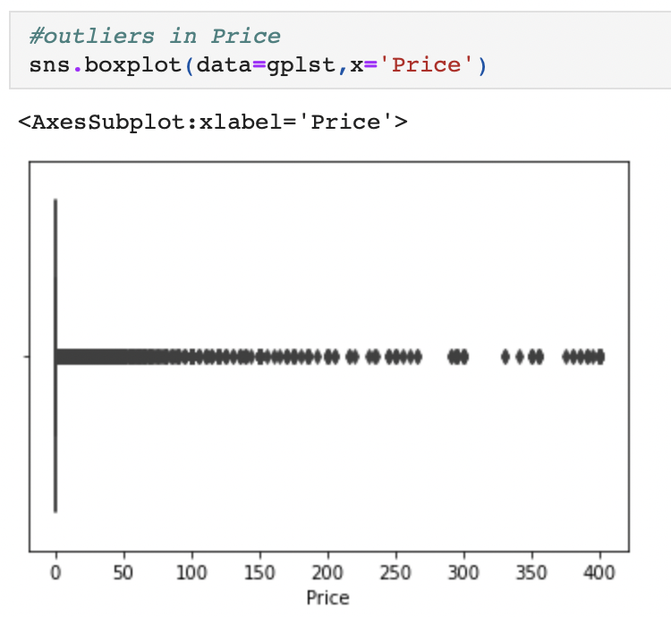
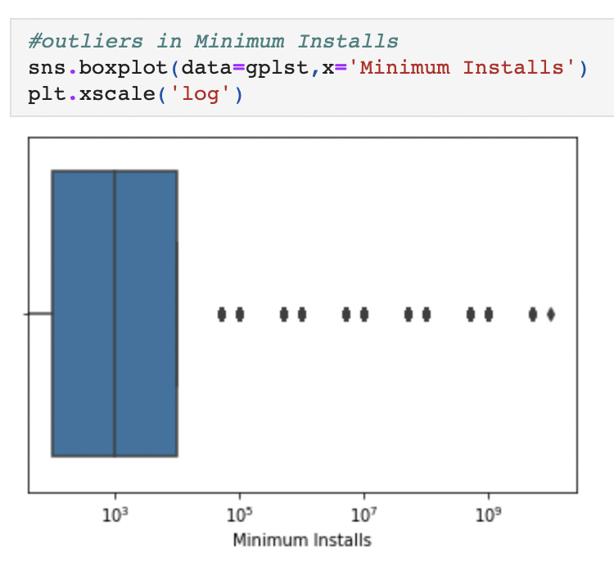
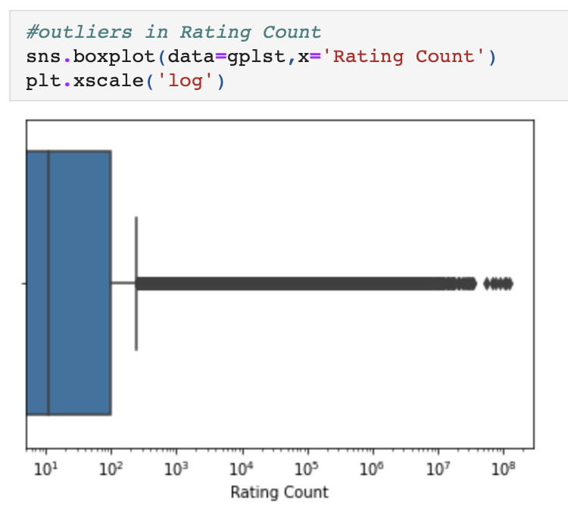
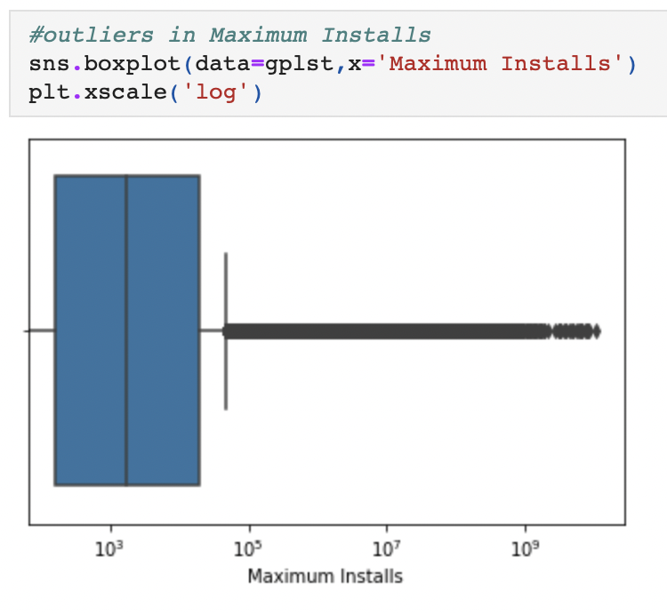
Finding outliers through boxplots :
Price :
Minimum Installs :
Rating Count:
Maximum Installs :

Slide 15
Data Cleaning
1 . Removing Unwanted Columns from Dataset :
We have selected 7 columns for our project App Name, Category, Rating, Installs, Price, Size and Ad Supported.
So, we deleted other unwanted columns from the Dataset.
2 . Merging Multiple Categories into One :
We merged some categories with the same meaning like “Music & Audio” and “Music” to ”Music” , “Educational” and
“Education” to “Education”.
3 . Converting Datatype of Columns :
We have converted datatype of Size and Installs columns to float.

Slide 16
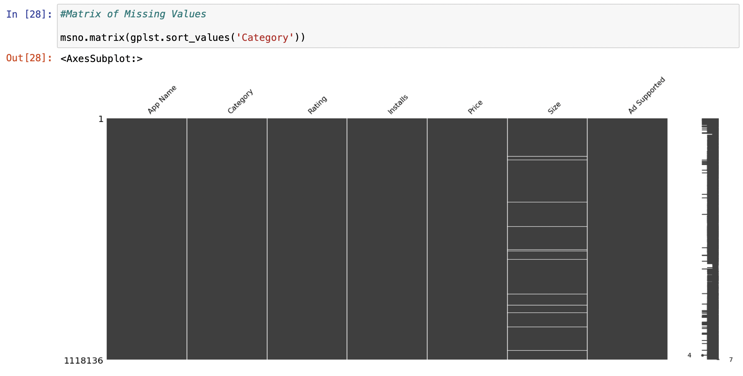
Matrix of Missing Values :

Slide 17
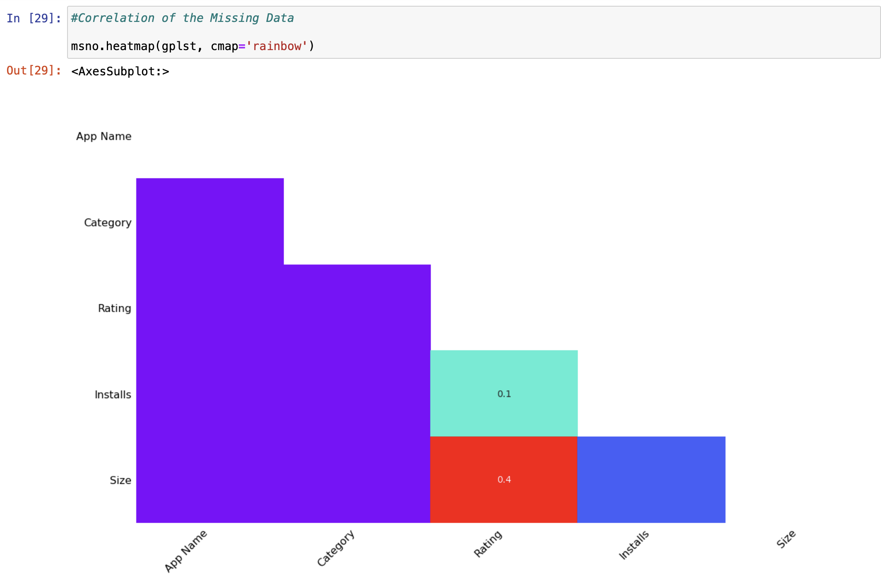
Correlation of the Missing Data :

Slide 18
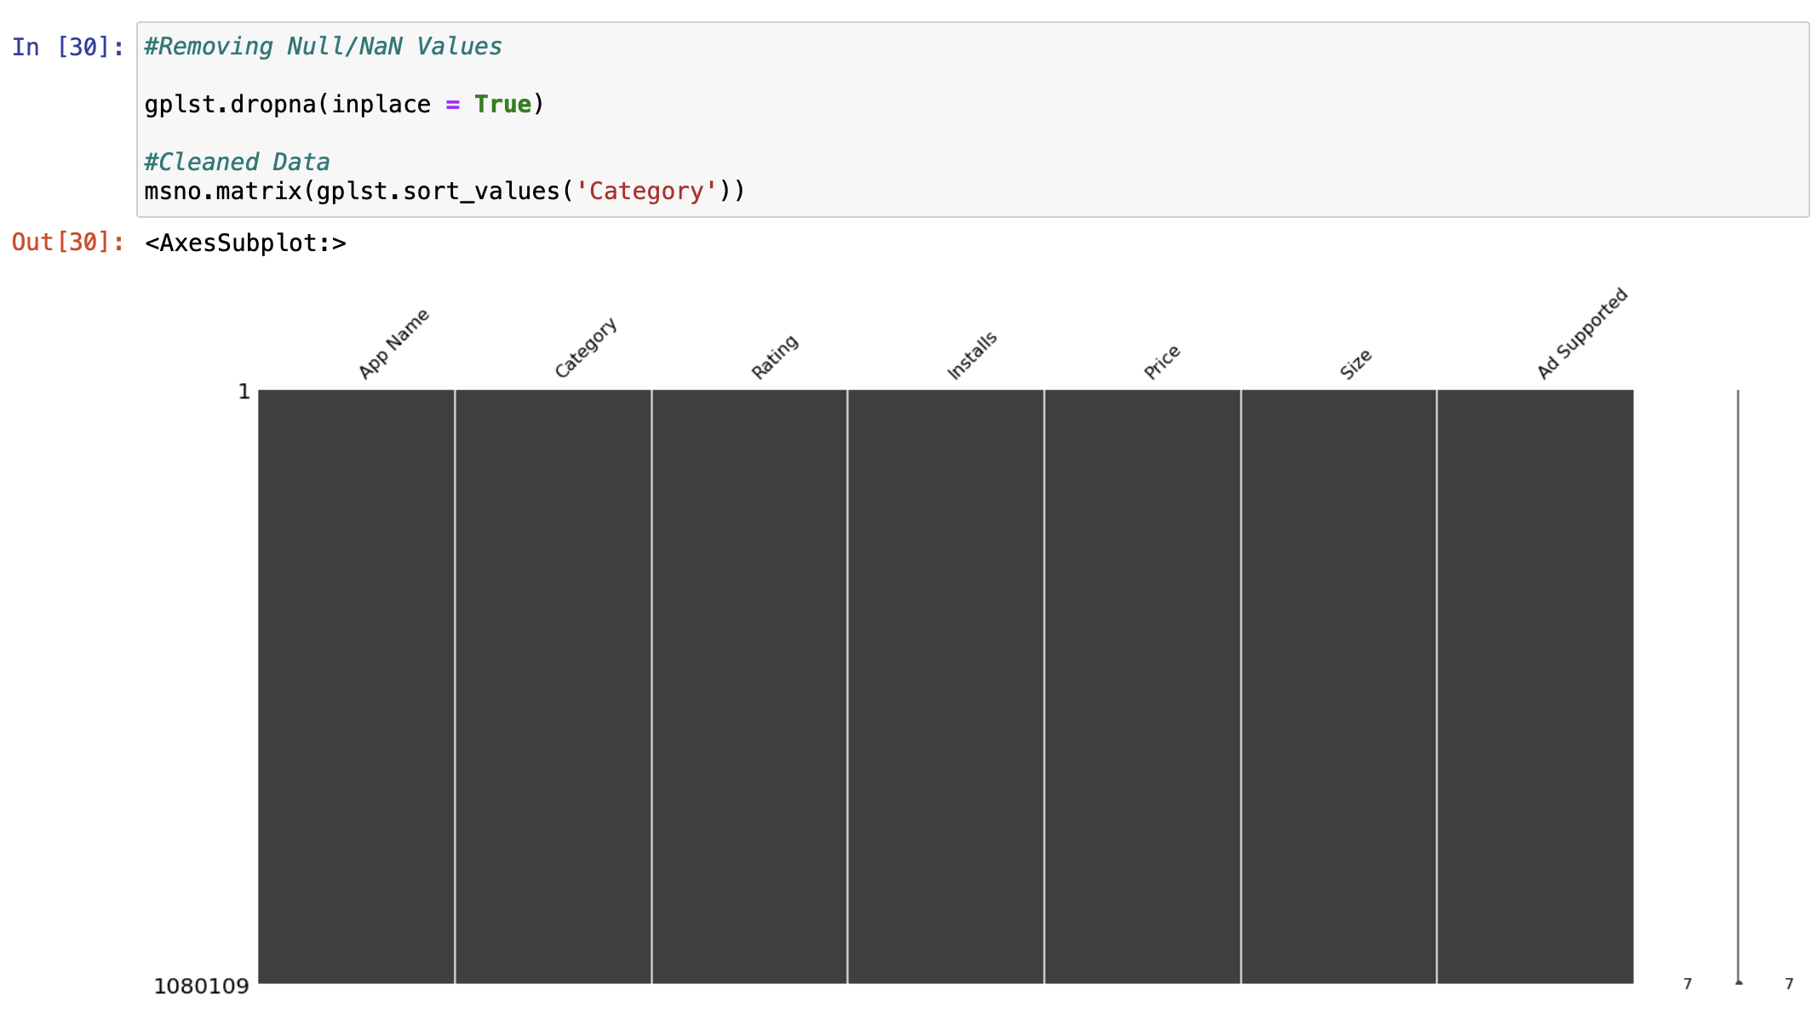
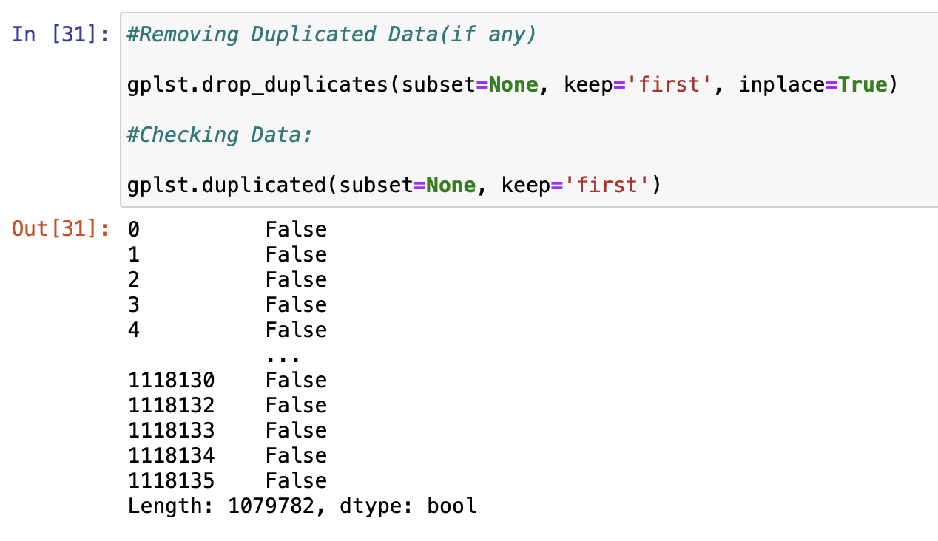
Removing All Null/Nan and Duplicate Values :

Slide 19
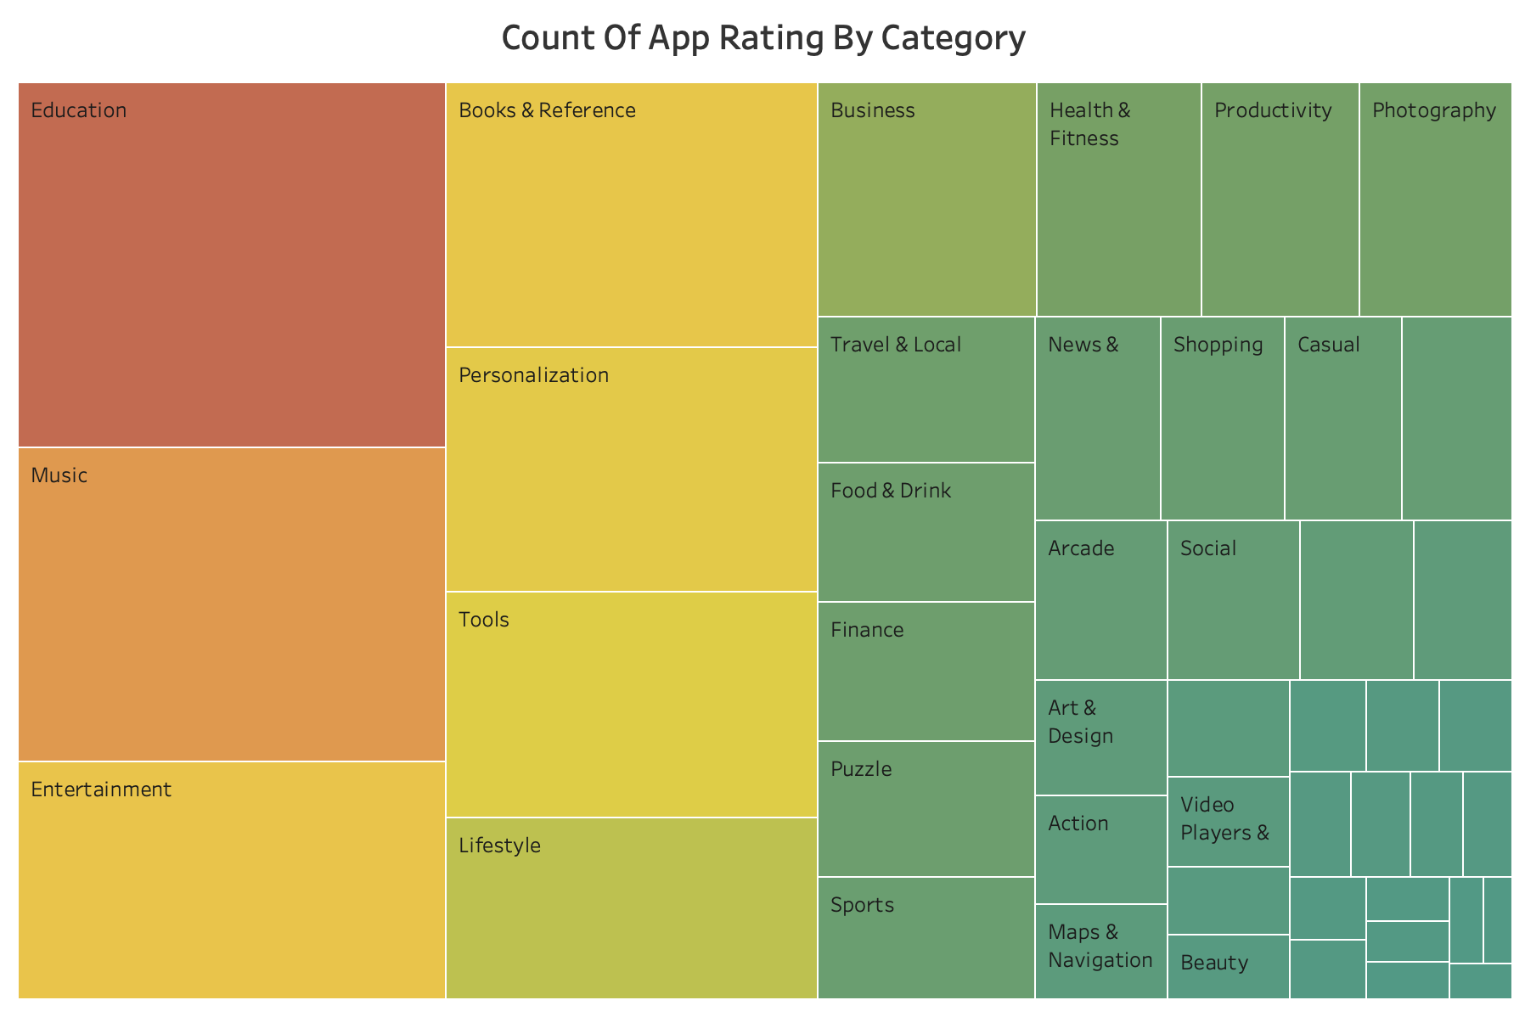
Data Analysis
By looking at this graph we can clearly say that Count of App Ratings for these fields Education , Music and Entertainment are very high compare to other fields.

Slide 20
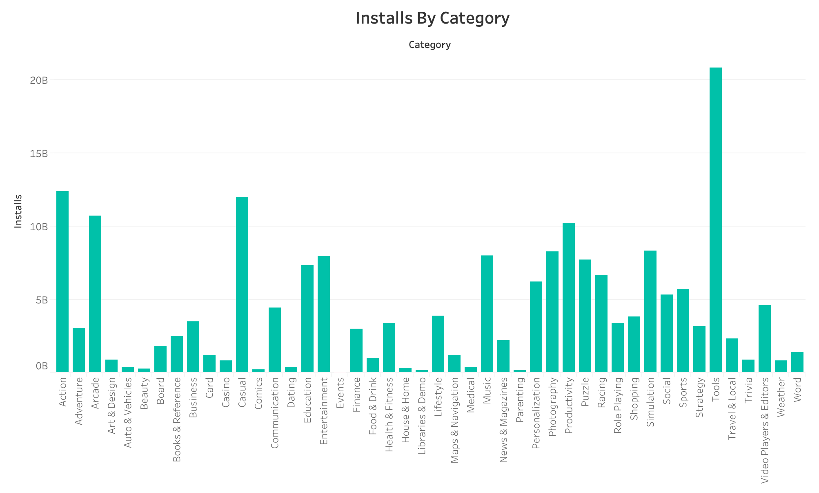
Data Analysis
From this Graph we can say that most people are interested in Tools, Casual, Arcade, Action and Productivity.

Slide 21
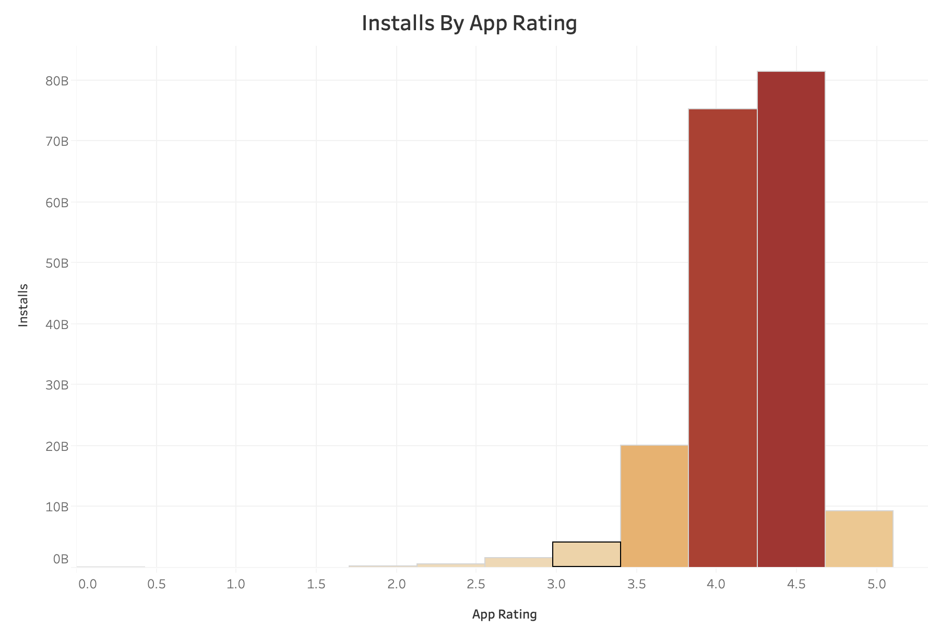
Data Analysis
From this plot, we can say that most people downloaded apps that have ratings between 4 to 5.

Slide 22
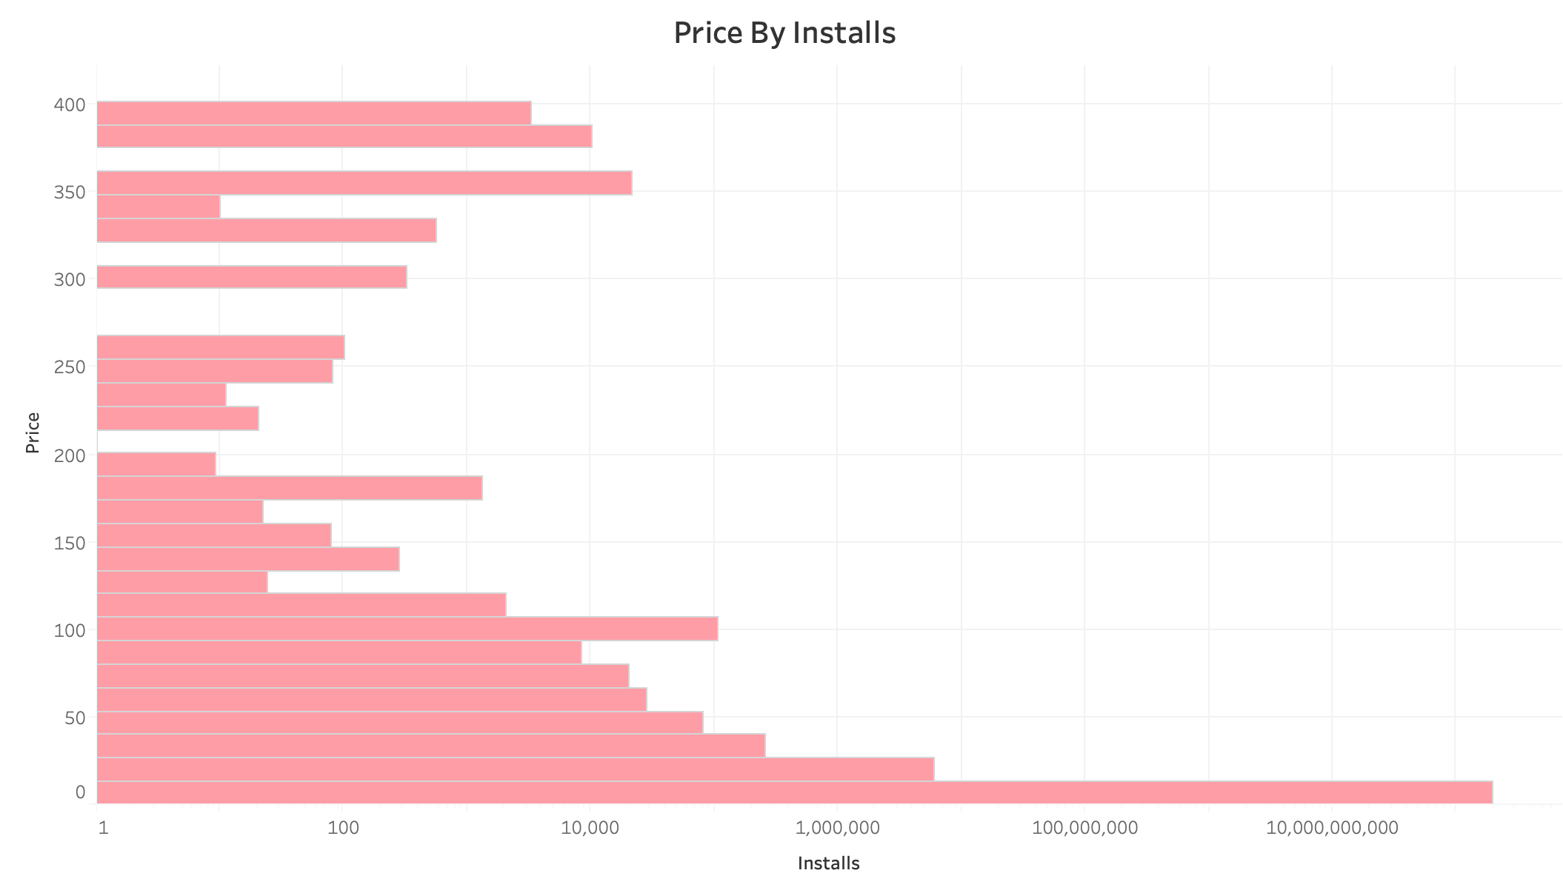
Data Analysis
Number of installs are higher when the price of apps are lower.
Most People would like to install free apps rather than paid ones.

Slide 23
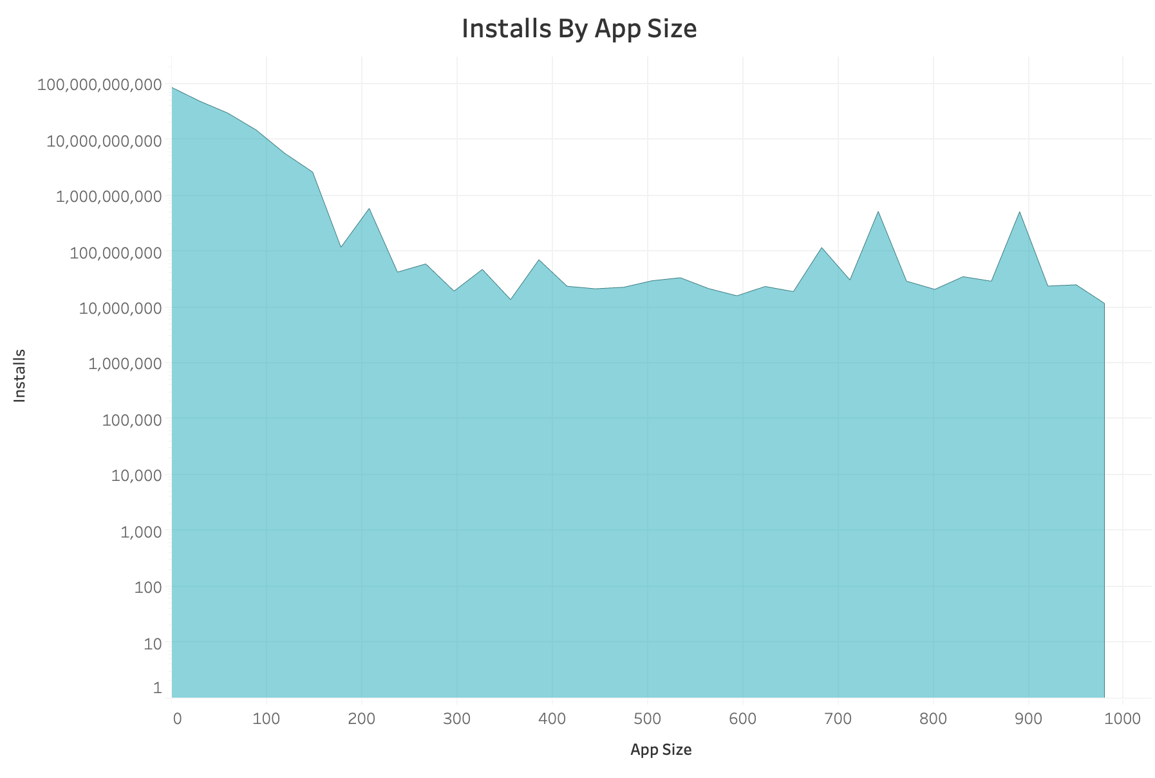
Data Analysis
This Graph depicts that, the Number of Installs gradually decreases when the size of the app increases.

Slide 24
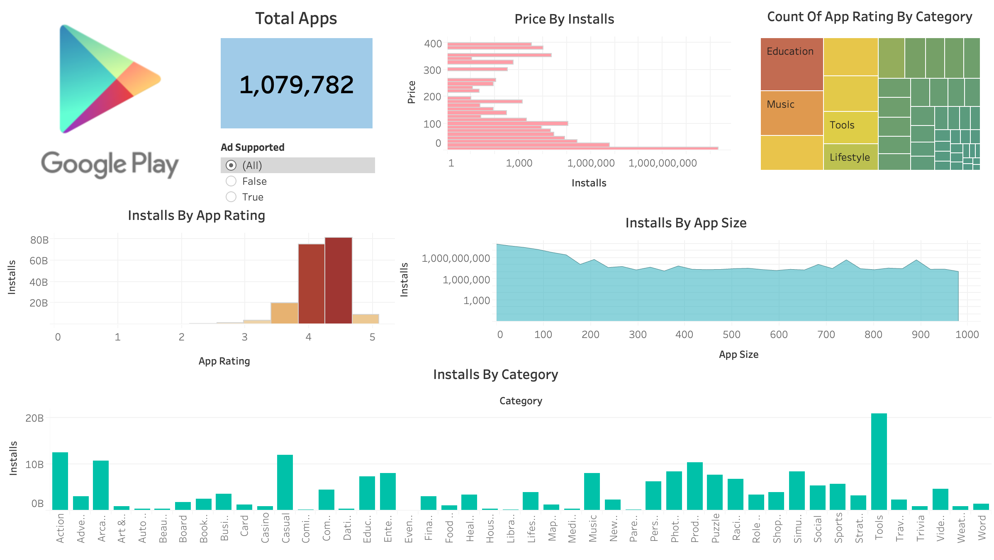
Dashboard

Slide 25
Conclusion
After performing all this analysis, we can clearly say that most people are looking for free Tools, Casual, Action, Arcade and Productivity apps.
So, It’s better to build an app of this kind for any App Developer and Organization because this type of apps will have more installs on Google Play-store.

Slide 26
Links of Project and Tableau
GitHub Link for Project :
https://github.com/Vishal26199/Google-Playstore
Tableau Public link of Dashboard :
https://prod-useast-b.online.tableau.com/#/site/vishalpatel/workbooks/81123?:origin=card_share_link

Slide 27
About Team
Vishal Patel
Jaimin Babariya
Sonam Thakur
Devanshi Patel

